Slide 1
Automating Tasks
Schedule Jobs
Implement Version Control Using Git
Identify Orchestration Concepts

Slide 2

Topic A: Schedule Jobs
Exam Objectives:
2.6 Given a scenario, automate and schedule jobs.

Slide 3
The at Command (Slide 1 of 2)
Runs a task once at a specified time.
Not designed for repetitive or regularly scheduled tasks.
You can specify a date/time or a period of time.
Usually used interactively.
Task is defined in prompt.
You can enter a path to a script or a command.
Press Ctrl+D to exit.

Slide 4
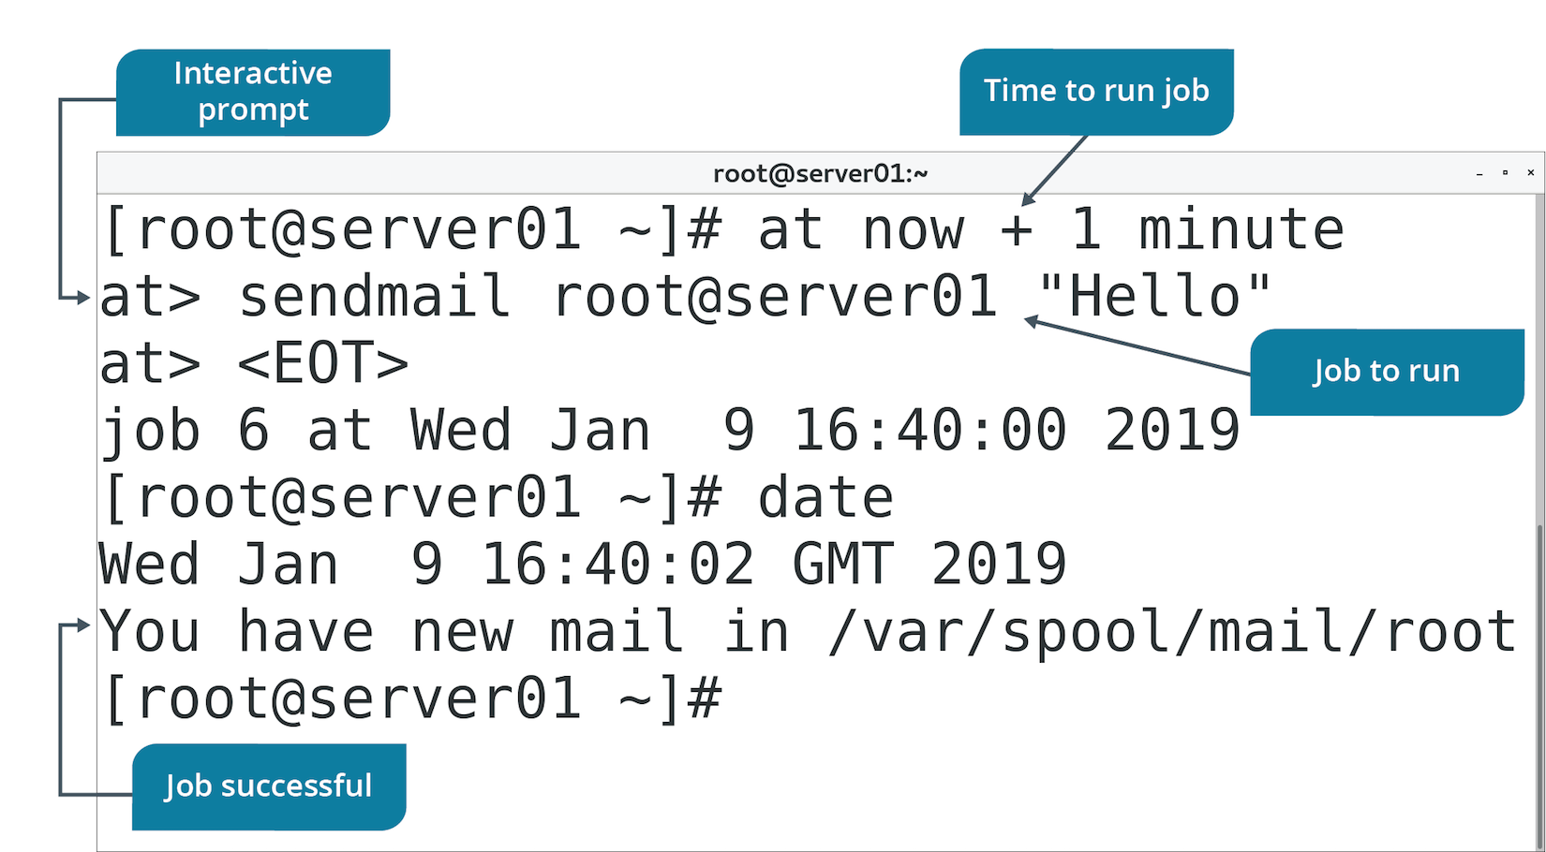
The at Command (Slide 2 of 2)

Slide 5
Cron Jobs
A scheduled task that is managed by the Linux cron daemon.
Users may want scripts or commands to execute regularly.
Automation makes tasks efficient and consistent.
cron daemon checks crontab file every minute.
Executes tasks that need to run.
Goes to sleep for a minute if there are none.
Cron jobs can specify tasks each:
Minute, hour, day, month, day of week.

Slide 6
The crontab Command (Slide 1 of 2)
Controls the cron daemon.
Assumes current user unless -u specifies other user.
Used to view, create, and delete crontab files.
Option | Used To
-e | Edit the crontab file for current user.
-l | View crontab file for current user.
-r | Delete crontab file.
-u | Create crontab file for a user.

Slide 7
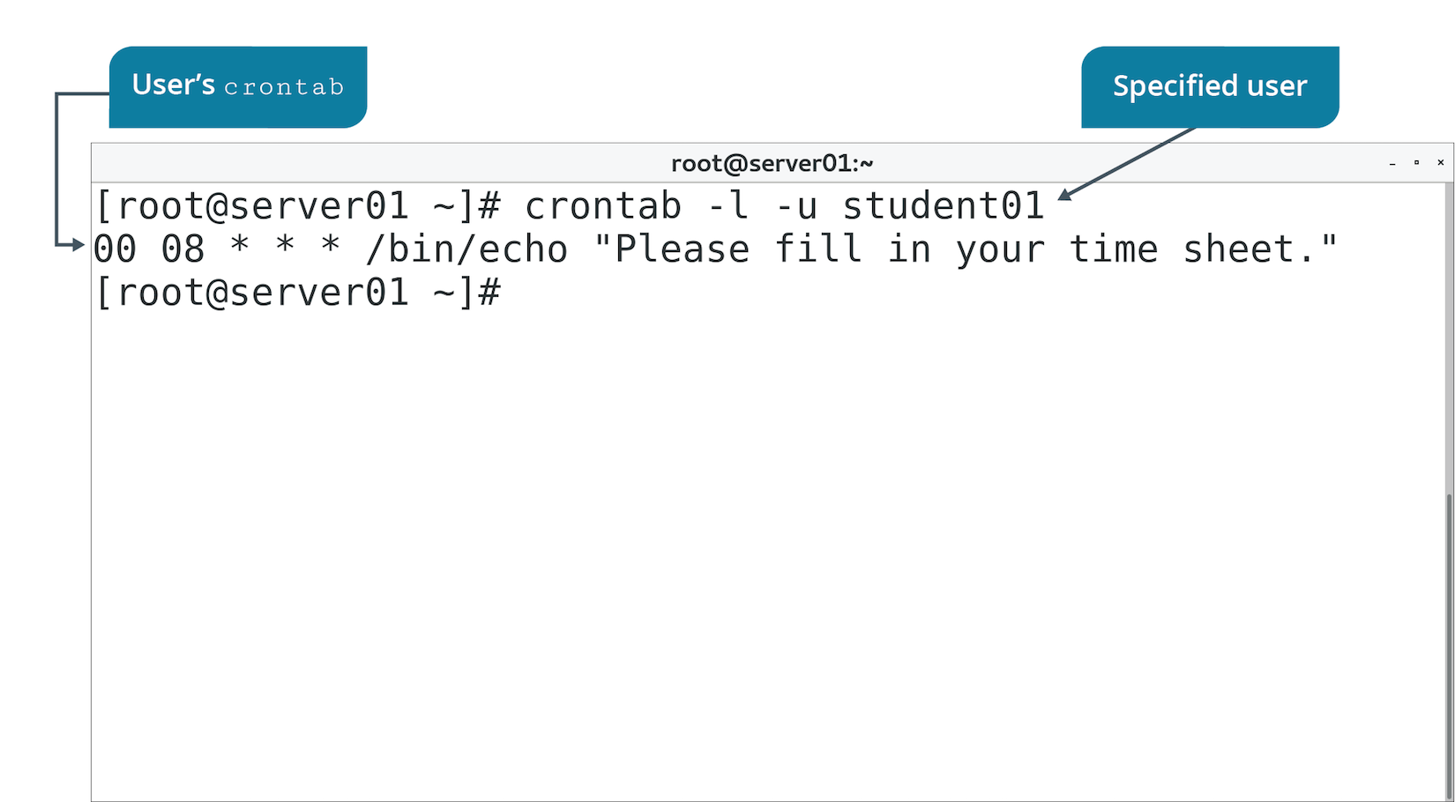
The crontab Command (Slide 2 of 2)

Slide 8
The crontab Files (Slide 1 of 2)
Define the scheduled tasks executed by cron daemon.
crontab -e opens file in default editor.
Used to specify what tasks to run and when.

Slide 9

The crontab Files (Slide 2 of 2)
Example lines:
* 20 * * 1-5 /path/to/command
15 2 * * * /path/to/command
30 4 1 * * /path/to/command

Slide 10
Cron Directories
crontab files for system in /etc/cron.d/
Root can schedule system-wide tasks.
Services can schedule tasks.
Not allowed for regular users.
Root can also add to /etc/crontab
crontab files for users in /var/spool/cron/
Regular users schedule own tasks.
Executes with user's credentials.
/etc/ directory also has:
/etc/cron.hourly, /etc/cron.daily, and so on.
Some distros pre-populate /etc/crontab

Slide 11
Discussing Scheduling Jobs

Slide 12
Activity 14-1: Discussing Scheduling Jobs
You are scheduling new backup tasks on every new Linux system that your team configures and manages. Each requires its key directories to be backed up. Would the at command or a cron job be best for scheduling the backup script? Why?
ANSWER:
A cron job is the correct choice because at is for running a task once, not for tasks that need repeating.

Slide 13
Activity 14-1: Discussing Scheduling Jobs
Anyone can schedule cron jobs. As a regular user, you need to schedule a file transfer from your local workstation to the shared directory on one of the development servers. You need to create a new cron job. Which command can you use to create the cron job?
ANSWER:
The crontab -e command is used to enter the crontab editor.

Slide 14
Activity 14-1: Discussing Scheduling Jobs
As the root user, you need to check all scheduled tasks that belong to root. How can you check them?
ANSWER:
Use the crontab -l command to display a list of scheduled tasks.

Slide 15
Activity 14-1: Discussing Scheduling Jobs
How can you remove an entry from the at command queue?
ANSWER:
The atrm command can be used to delete a scheduled task.

Slide 16
Activity 14-1: Discussing Scheduling Jobs
You have added several jobs to the at queue and you need to check the status. How can you check the at queue?
ANSWER:
Use the atq command.

Slide 17
Activity: Scheduling a Single Task
Developers need to execute a task after hours.
Schedule is not predictable.
You'll use at to satisfy this requirement.

Slide 18
Activity: Scheduling Repeated Tasks
New Develtech policy requires users to fill in time sheets.
You'll create a daily reminder.
Notes:
Teaching Tip: Consider changing the time that students must wait for the scheduled task to execute.

Slide 19
Topic B: Implement Version Control Using Git
Exam Objectives:
5.2 Given a scenario, carry out version control using Git.

Slide 20
Git
A distributed version control system primarily used by developers who are collaborating on projects.
Developed by Linus Torvalds.
The standard version control program in the development world.
Often integrated with development editors.
Core component is Git repository.
Storage area for code and related files.
Version control managed here.
Can be stored locally or on central repo (e.g., GitHub).
Install the git package to get started.

Slide 21
The git Command
Manages Git repositories.
Use to:
Create repo.
Add files to repo.
Commit changes to repo.
Pull down files from another repo.
And more.
Perform tasks through various subcommands.

Slide 22
git Subcommands
Subcommand | Used To
config | Set options for a repo, Git users, or global.
init | Create or reinitialize a repo.
clone | Create working copy of a repo.
add | Add files to be tracked by repo.
commit | Update repo with your changes.
status | Display status of repo.
branch | Manage branches (pointers to specific repo snapshots).
merge | Integrate changes from one branch into "master" branch.
pull | Acquire and merge changes made to other repos and branches.
push | Upload local working copy of a repo to a remote repo.
log | Display changes made to local repo.
checkout | Switch to specific branch.

Slide 23
Example Git Process for Local Repositories
Configure settings:
git config --global user.name 'User'
git config --global user.email 'user@domain.tld'
Create a directory for project:
mkdir /dev-project
git init /dev-project
Add project files to repo:
git clone /dev-project
Add project files for tracking:
git add myfile
Commit changes:
git commit -m 'Initial commit'
Retrieve status of files:
git status

Slide 24
Example Git Process for Collaboration
Pull others' changes and merge them into local repo:
git pull otherbranch
Push your changes to remote repo:
git push <remote repo> mybranch
Review what actions were taken:
git log
Switch between branches:
git checkout specificbranch

Slide 25
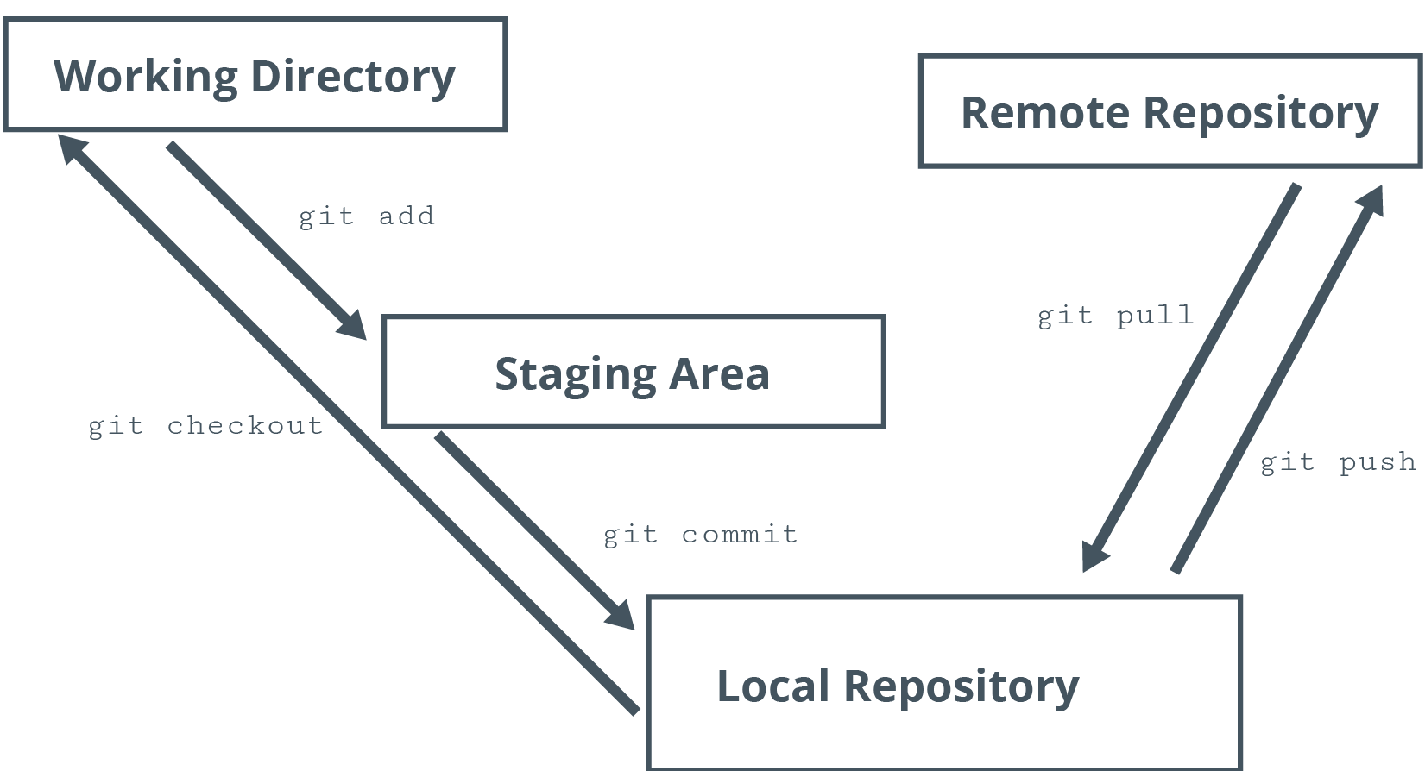
Example Git Process Flow

Slide 26
Git Files
.gitignore specifies files to ignore in commit action.
Example: Ignore README.txt
*.git/ directory contains files used to manage version control.
Location where Git stores all info.
Resides in project directory.
Created with git init command.

Slide 27
Discussing Version Control Using Git

Slide 28
Activity 14-4: Discussing Version Control Using Git
You need to set up a new Git repository for a group of developers. Which command begins the process of setting up a new Git repository?
ANSWER:
git init

Slide 29
Activity 14-4: Discussing Version Control Using Git
Your developer group wants to implement Git so that they can manage code versioning. They ask you to install it on the dev01 CentOS server. How can you install Git?
ANSWER:
sudo yum install git

Slide 30
Activity 14-4: Discussing Version Control Using Git
You have created a new file, statistics.txt, and want to add it to the Git repository. Which command can you execute to add the file?
ANSWER:
git add statistics.txt

Slide 31
Activity 14-4: Discussing Version Control Using Git
Over the past week, you have made several changes to the markets.txt file but have not committed those changes. How can you commit the changes?
ANSWER:
Run git add markets.txt and then run git commit -m "Week 1 Changes"

Slide 32
Activity 14-4: Discussing Version Control Using Git
Having returned from vacation today, you want to check the progress of the new coding project your group is working on. Which command can you issue to check the revision history of the repository?
ANSWER:
git log

Slide 33
Activity: Implementing Version Control Using Git
Development teams to manage different versions of code.
Multiple developers will work in conjunction on same project.
Need to minimize conflicts with code versions.
You'll set up a Git repo.
Developers will have a distributed version control system.

Slide 34
Topic C: Identify Orchestration Concepts
Exam Objectives:
5.3 Summarize orchestration processes and concepts.

Slide 35
Orchestration
The automation of multiple related tasks.
Consists of an entire workflow.
Example: Web app deployment includes:
Installation/configuration of web server.
Installation/configuration of MySQL database.
Installation/configuration of app server and supporting software.
Manages each step, even though requirements may differ.
Used both on-premise and in the cloud.

Slide 36
Infrastructure Automation
Automation is accomplishing a task without human intervention.
Automation refers to a single task.
Example: Admin automates Python installation for Linux deployment.
Orchestration is a series of automation tasks.
Accomplishes large-scale deployments.

Slide 37
Build Automation
Emphasizes initial OS deployment.
Example: Using Kickstart files with RH distros.
Files referenced during installation.
OS is deployed according to file configs.

Slide 38
Infrastructure as Code
The process of configuring/deploying infrastructure through programming scripts and other code files.
Rather than through traditional software tools.
Relies on single config specification.
Used to deploy infrastructure (OS) and apps.

Slide 39
Orchestration Tools
Tool | Description
Ansible | Uses YAML files to create repeatable playbooks. Playbooks define desired config state. Agentless solution that uses SSH to deliver files.
Puppet | Uses manifest files to define infrastructure as code. Uses agents on target nodes.
Chef | Uses cookbooks to deliver config declarations. Used in cloud and on-premises.
Kubernetes | Provides container deployment/app orchestration. Kubernetes configures containers to match desired state.
OpenStack | Typically deployed as IaaS. Can orchestrate LAMP stack.

Slide 40
Procedures
Vary by solution.
Usually involve:
Defining desired config.
Delivering config to destination systems.
Processing of config.
Chef example:
Admin configures/tests "cookbook" of configs.
Cookbook is delivered to destination systems.
Chef client processes cookbook to configure nodes.

Slide 41
Attributes
Define tasks to be managed by orchestration.
Use attributes to identify specific configurations needed.
Example: OpenStack orchestration relies on attributes.

Slide 42
Inventory Management
Tools manage inventory like:
Hardware
VMs
OSes
Apps
Configurations
Different tools have different features.
Inventory is crucial because you can't manage what you don't know about.

Slide 43
Automated Configuration Management
Configures systems consistently.
More efficient build process.
Enforces security requirements.
Enforces SLAs.
More efficient change management.

Slide 44
Activity: Identifying Orchestration Concepts
Develetech is expanding into web hosting.
You've been asked to research orchestration.
Can make hosting more efficient and cost-effective.

Slide 45
Activity 14-6: Identifying Orchestration Concepts
What is the difference between automation and orchestration? Why does this difference matter to Develetech?
ANSWER:
Answers may vary, but automation manages one specific task, while orchestration manages an entire process or combination of individual tasks. It matters because orchestration benefits occur on a much larger scale than automation—for example, with the deployment of an entire web app solution.

Slide 46
Activity 14-6: Identifying Orchestration Concepts
Give examples of open source orchestration tools used in enterprises.
ANSWER:
Ansible, Puppet, Chef, Kubernetes, and OpenStack are all examples of open source orchestration tools.

Slide 47
Activity 14-6: Identifying Orchestration Concepts
Explain the three general steps in orchestration.
ANSWER:
1) Administrators create a set of instructions or configurations. 2) The orchestration tools deliver the instructions and configurations to client systems. 3) The orchestration clients process the instructions and configurations.

Slide 48
Activity 14-6: Identifying Orchestration Concepts
Ansible is a very popular orchestration tool in both large and small company networks. How does Ansible deliver configuration files to nodes?
ANSWER:
Ansible delivers files over SSH connections using an agentless solution.

Slide 49
Activity 14-6: Identifying Orchestration Concepts
Develetech will be providing LAMP (Linux, Apache, MySQL, PHP) web hosting packages for customers. How might orchestration benefit Develetech in this context?
ANSWER:
Answers may vary. Orchestration can manage the entire deployment and configuration process of LAMP services. It can automate the deployment steps of Linux, the configuration of the Apache web service, database population of the MySQL database service, and the installation of the PHP programming language (or Perl or Python) components.

Slide 50
Activity 14-6: Identifying Orchestration Concepts
Can orchestration help Develetech with cloud-based web hosting? Why or why not?
ANSWER:
Answers may vary, but for the most part, yes, orchestration works well with the cloud solutions of on-demand self-service and rapid elasticity.

Slide 51
Do you, or would you, consider using a version control system like Git? Why or why not?
What kind of cron jobs might you create on your Linux systems?

